Slide 1
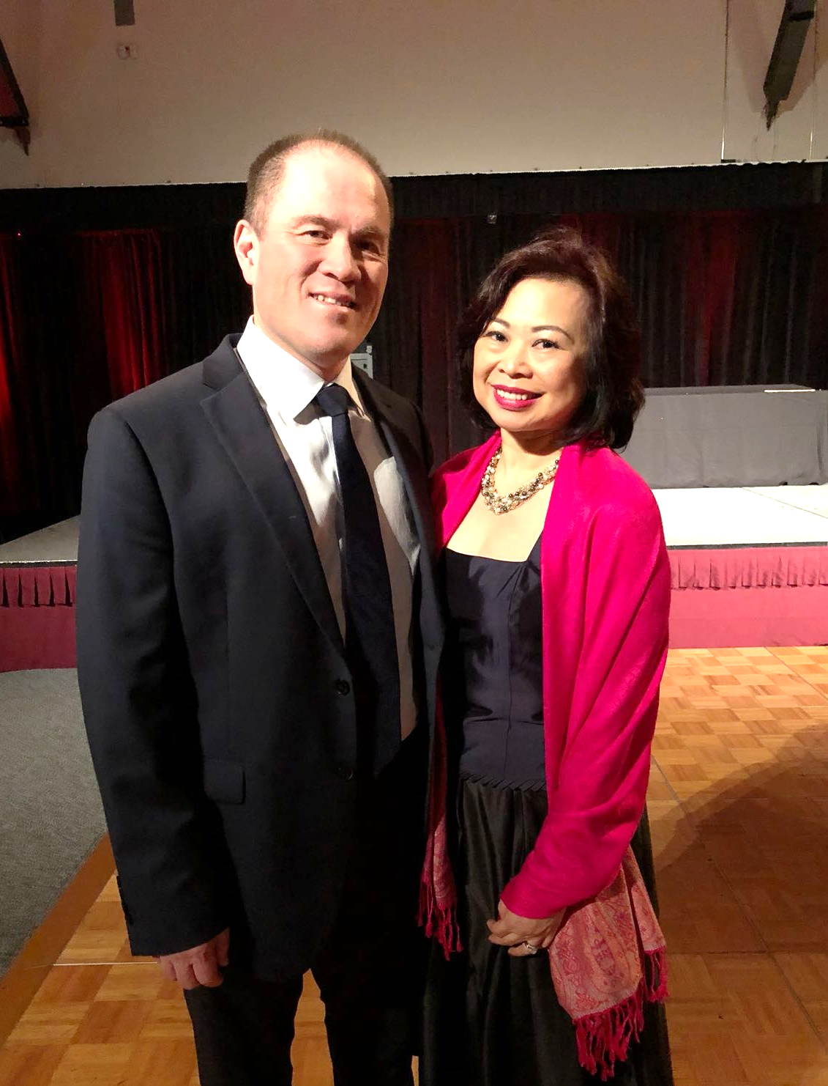
Why everyone should own an
UNFRANCHISE BUSINESS
Personal Assistant at a Law Firm
Perth UBP Coordinator since 2015
Market Australia ECCT Trainer since 2016
2016 & 2017 Market Australia Motives Certified Trainer
Master UFO (multiple times)
SAMM (multiple times)
Kevin Lee & Elaine Tang
Senior Master Coordinator
Perth, Australia

Slide 2
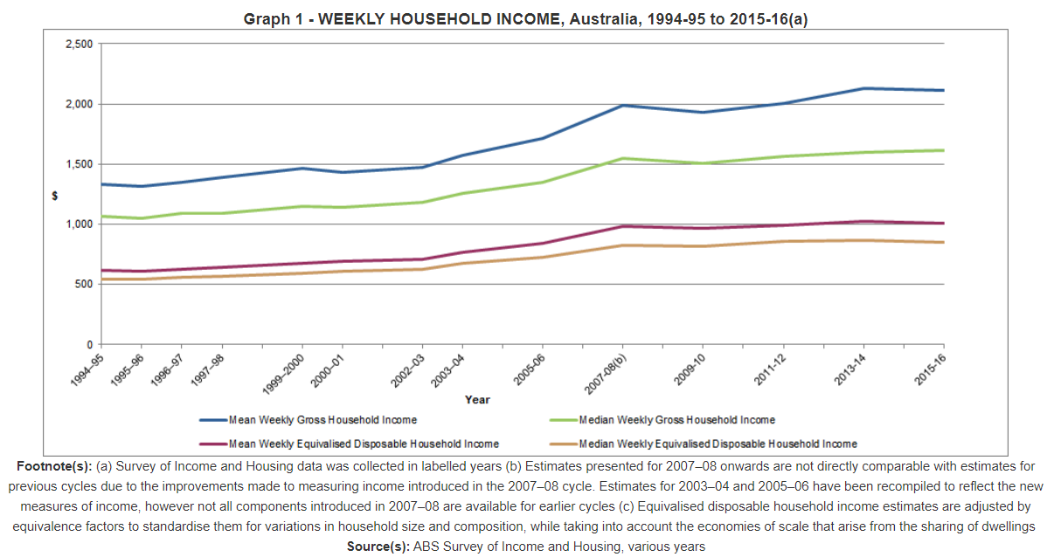
$1,400
$700
$2,100

Slide 3
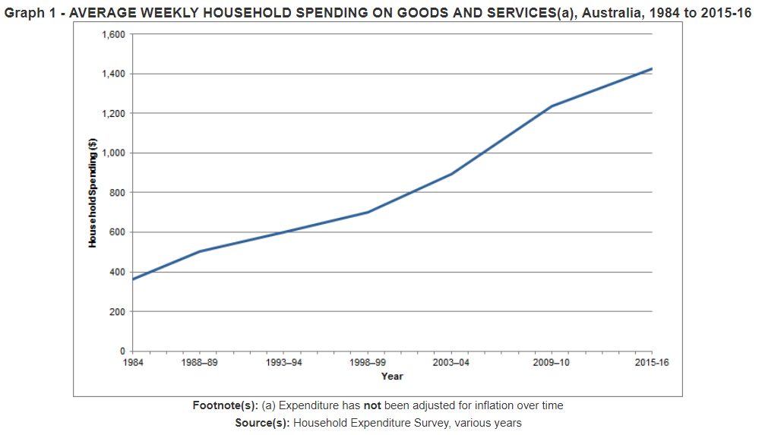
$1,400
$800
$600
Source(s): Australian Bureau of Statistics

Slide 4
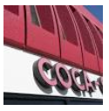


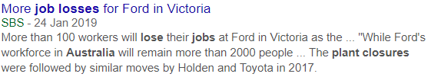
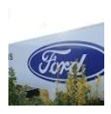
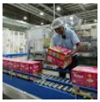


Slide 5
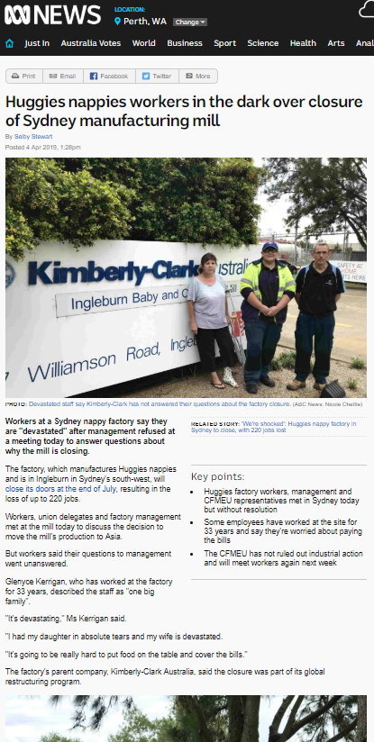
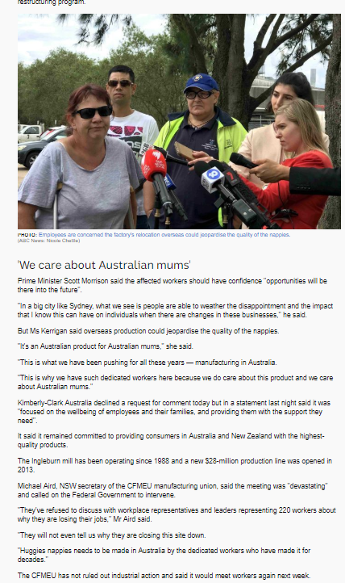
Prime Minister Scott Morrison said the affected workers should have confidence "opportunities will be there into the future".
"In a big city like Sydney, what we see is people are able to weather the disappointment and the impact that I know this can have on individuals when there are changes in these businesses," he said.

Slide 6
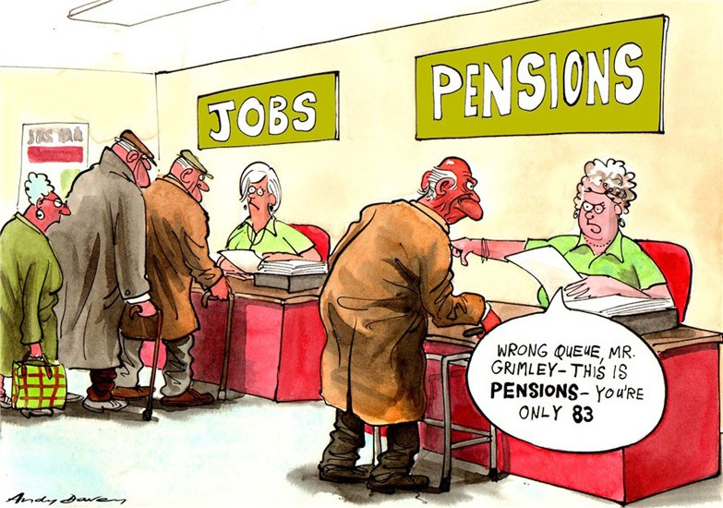


Slide 7






What are your options?
Working more hours
Investments
Going back to school
Get a second job
Own your own business

Slide 8

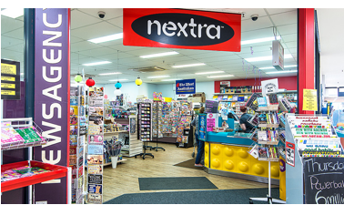
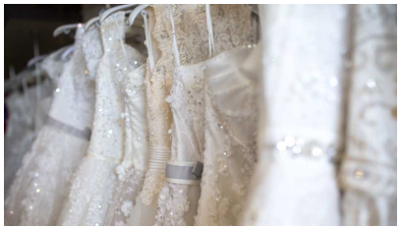

ALL IN

Slide 9
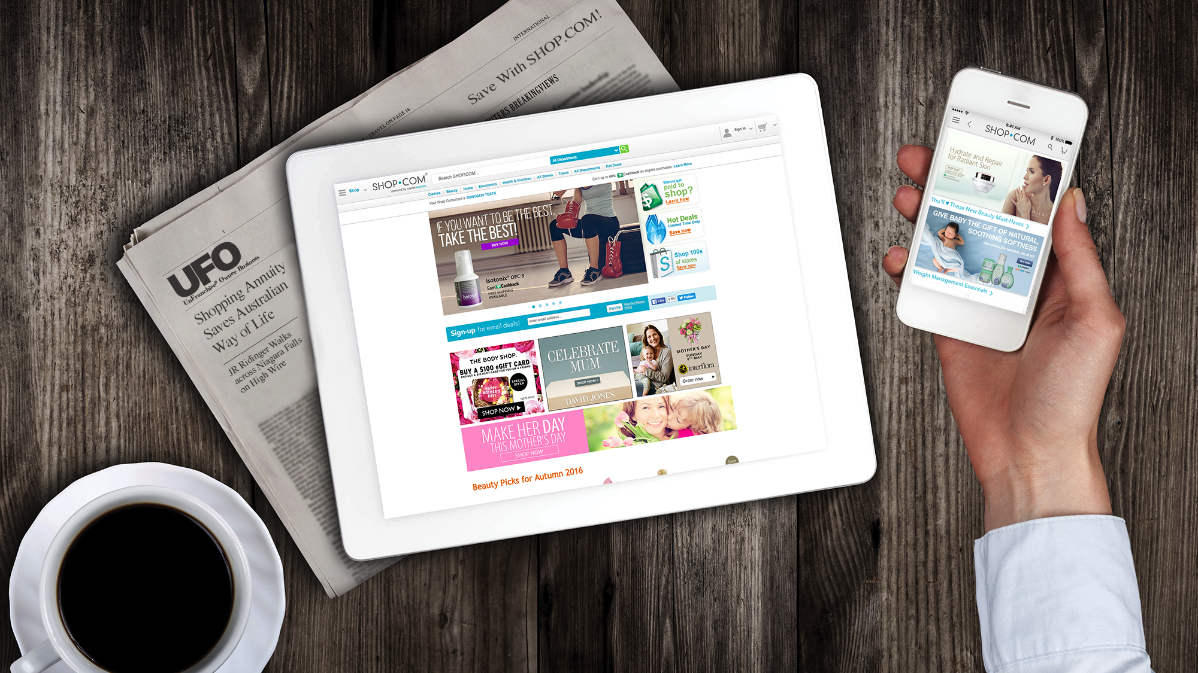
[
]
THE UNFRANCHISE® BUSINESS
Copyright © 2018 Market America Worldwide

Slide 10
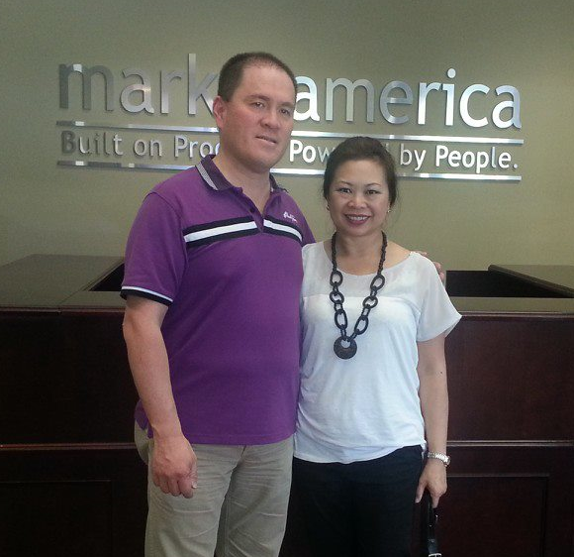
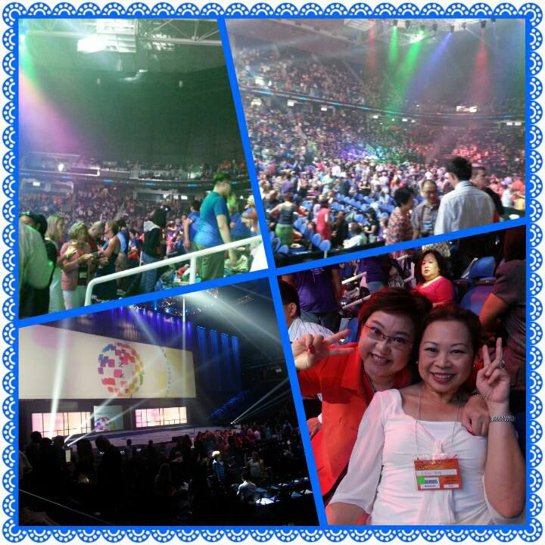
Market America Headquarters
2013 International Convention - Greensboro

Slide 11
Why Unfranchise Business?

Slide 12
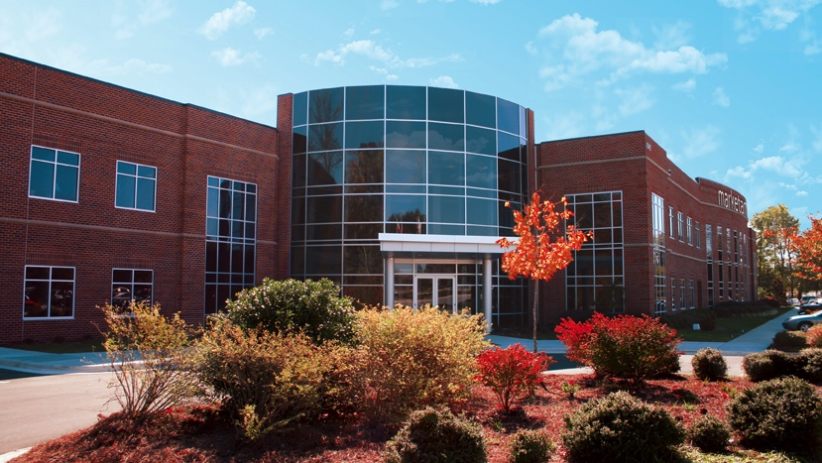


A GLOBAL PRODUCT BROKERAGE AND INTERNET MARKETING
COMPANY THAT SPECIALISES IN ONE-TO-ONE MARKETING
2013 & 2018 Torch Award Winner
BBB of Central NC
Trust • Performance • Integrity
GREENSBORO, N.C.

Slide 13
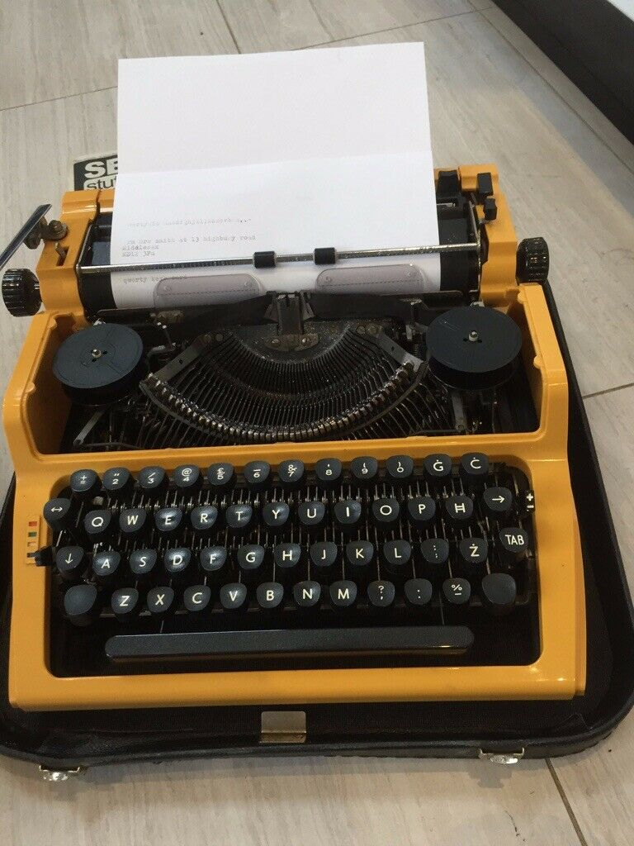
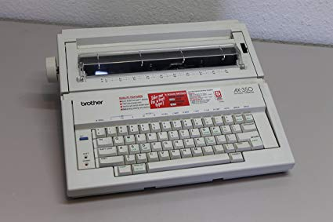

Slide 14
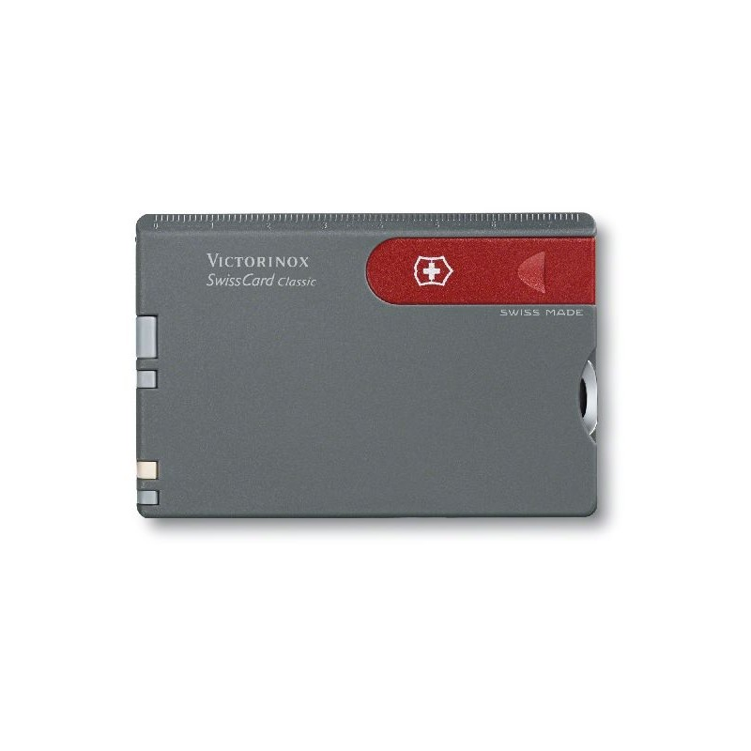
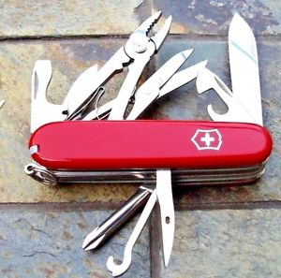

Slide 15
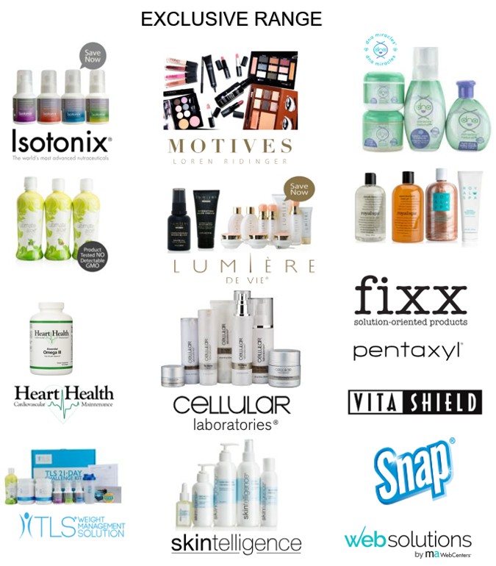
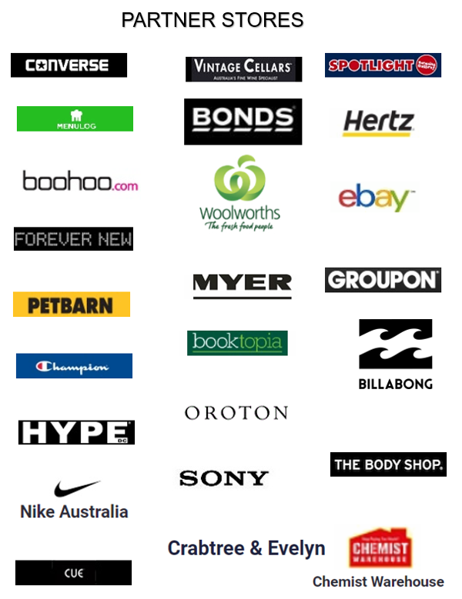

Slide 16
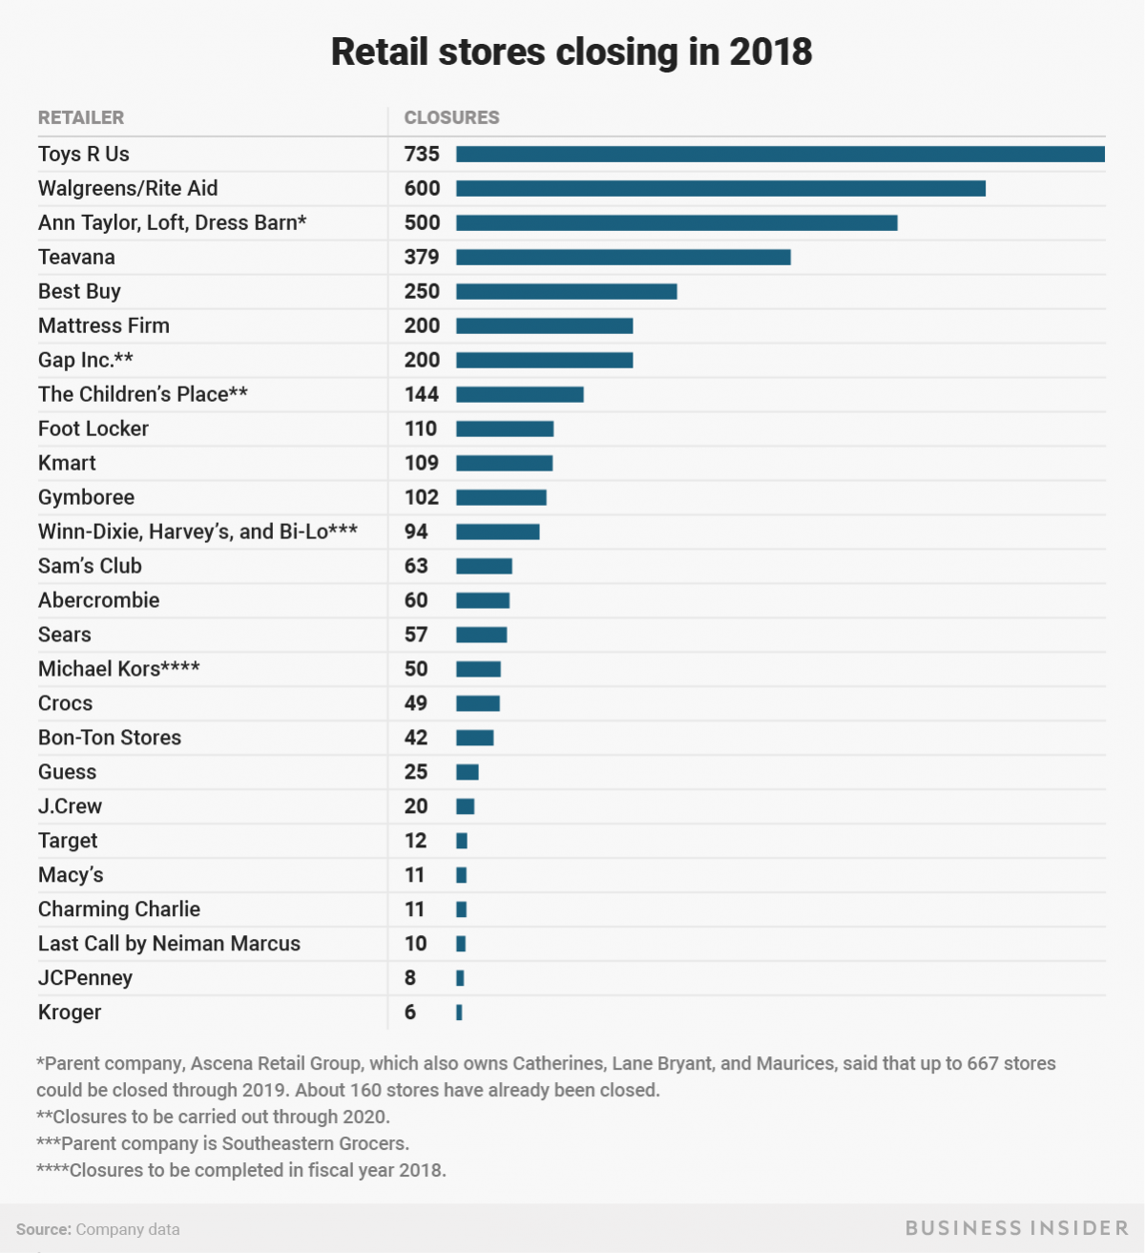
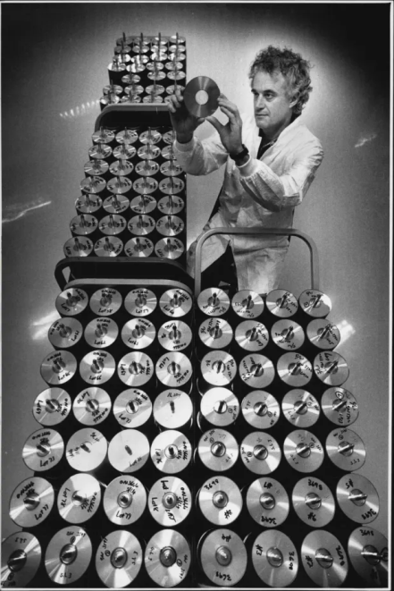
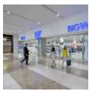
Australia’s vanishing stores
Sony's Australian music sales boom but disc-making a bust
https://www.afr.com/.../sonys-australian-music-sales-boom-but-discmaking-a-bust-2018...
Jul 23, 2018 - The Sony subsidiary that made CDs, DVDs and Blu-rays has shut its Western ... 320 employees were affected by the factory's closure, which followed the ... Sony Music Entertainment Australia Pty Ltd reported sales of $119.3 ...
Woolworths to shut 30 of its Big W stores amid retail gloom
ABC News-31 Mar 2019
Woolworths chief executive Brad Banducci said the goal of the store closures was to help boost the profitability of remaining Big W stores.

Slide 17
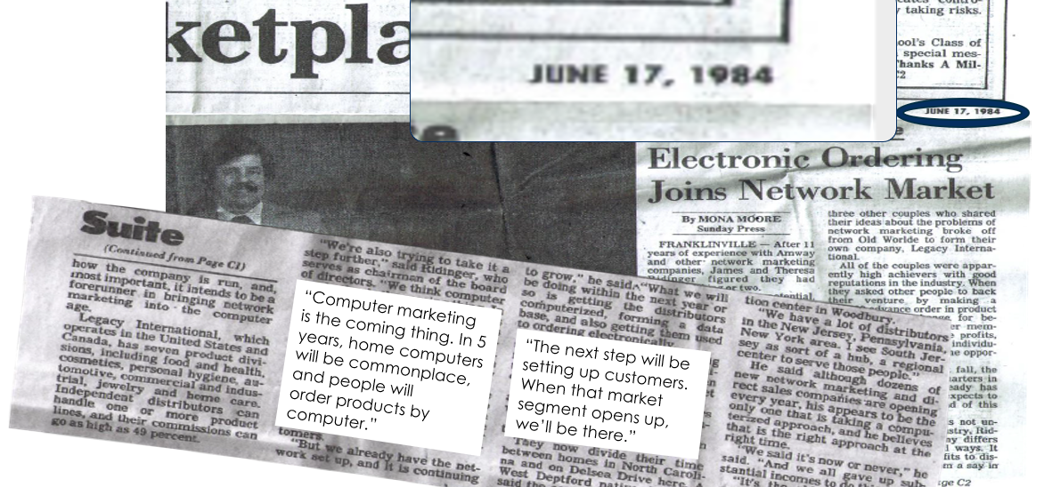

Slide 18
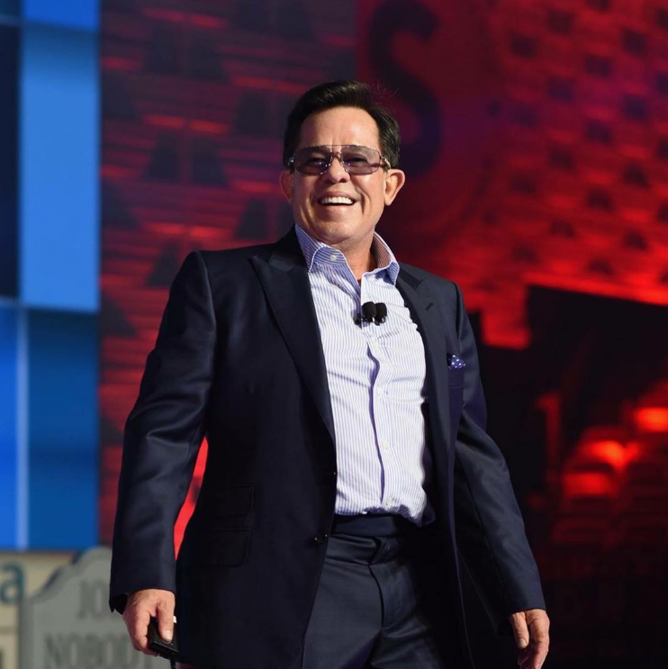
Before the market was ready
JR was already doing it

Slide 19

BV
Exclusive Products
Health / Beauty / Personal Care / Web Centre
Free Registration
IBV
Preferred
Customers
Affiliated Partner Stores
Cashback Program
Over 4000 PS
Convert Spending into Earnings = $$$
UFO
UFO
UFO
1: Accrue BV / IBV
2: 30% retail profit
UFO
UFO
3: Residual Income

Slide 20


Slide 21
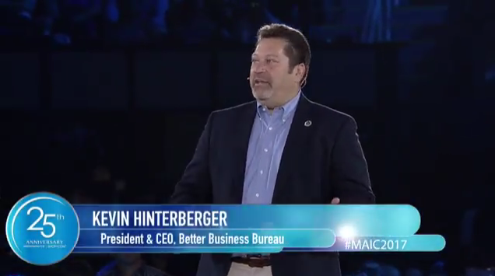


2018 Winner!
“Market America is a company that builds trust, advertises honestly, and are responsive to their customers”
… Kevin Hinterberger

Slide 22


in the
2016 social 500
rank
#39
Social commerce
Social engagement
Follower base
content

Slide 23
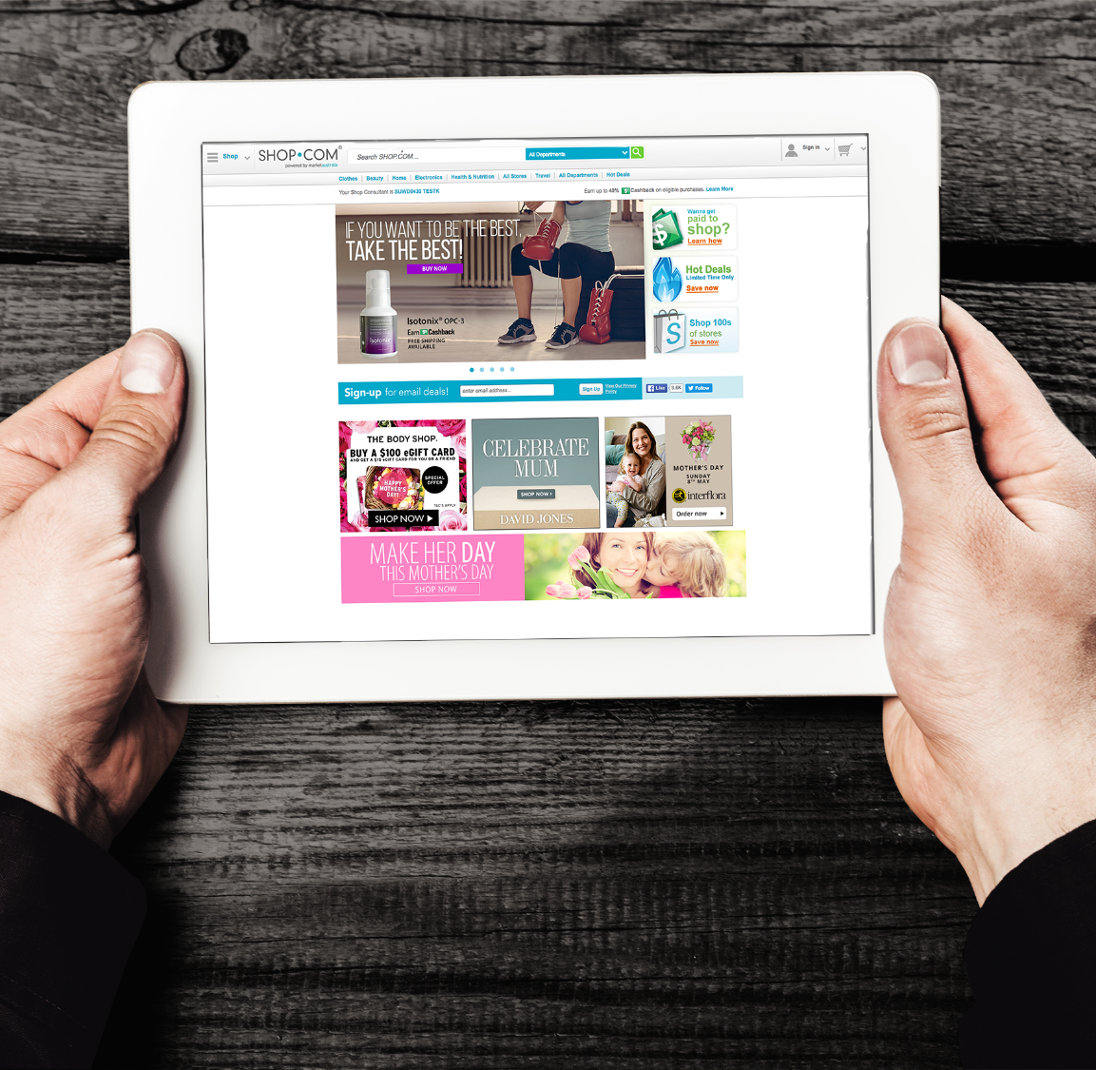
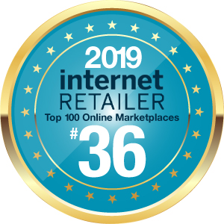

Slide 24

Always looking for ways
Simplify, Streamline & Standardize
the day- to- day operations of your Business.

Slide 25






Growing globally
The Asia pacific has grown exponentially
  Australia
  Taiwan
  Hong Kong
  Next
  Thailand
  Singapore
  Malaysia

Slide 26

Global Meeting, Training and Seminar System (GMTSS)
A proven system of meetings, seminars and events that provide new and established UnFranchise® Owners with individual learning opportunities that contribute to standardised and effective training.

Slide 27
Group Interviews/ Business Lunches
Home Business Presentation
2-on-1
Webinar
General Business Trainings
NUOT, Basic 5, ECCT
UnFranchise® Business Presentation (UBP)
University Specific Trainings
Health, TLS, Motives, WebCenter etc
Local Seminars
Market Australia Annual Convention
International Convention
World Conference

Slide 28




Minimal Startup Expenses
No Franchise Fees / Royalties
Vertical Marketing System
[
]
UNFRANCHISE BUSINESS
Encourages Team Work

Slide 29

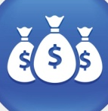

Proven System
Unlimited Income Potential
Willable Asset
[
]
UNFRANCHISE BUSINESS
Worldwide Training/Support

Slide 30
[
]
Position yourself for SUCCESS
Own an UNFRANCHISE BUSINESS
Copyright © 2018 Market America Worldwide

Slide 31



Slide 32
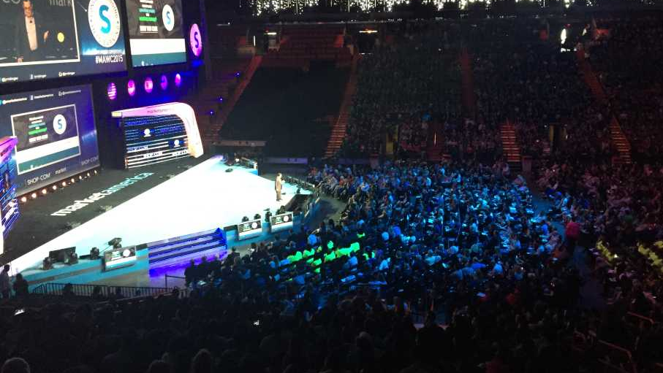
SYSTEM
Save
Yourself
Stress
Time
Energy
Money

Slide 33
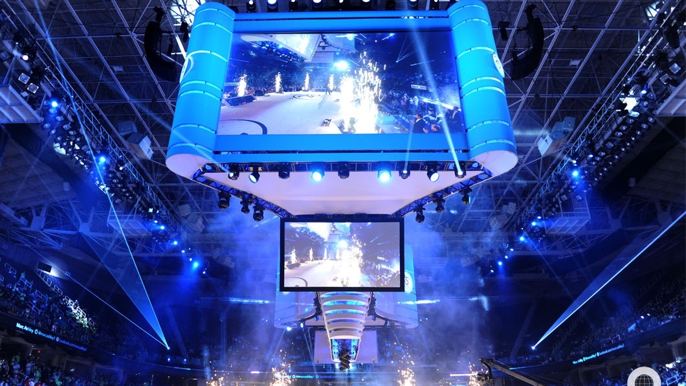

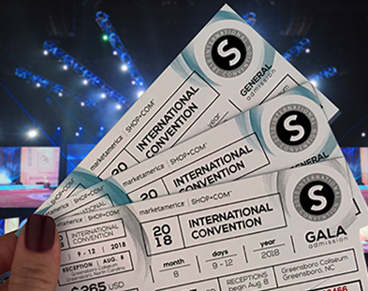
Market Australia Annual Convention
2020
Plug your team to GMTSS

Slide 34
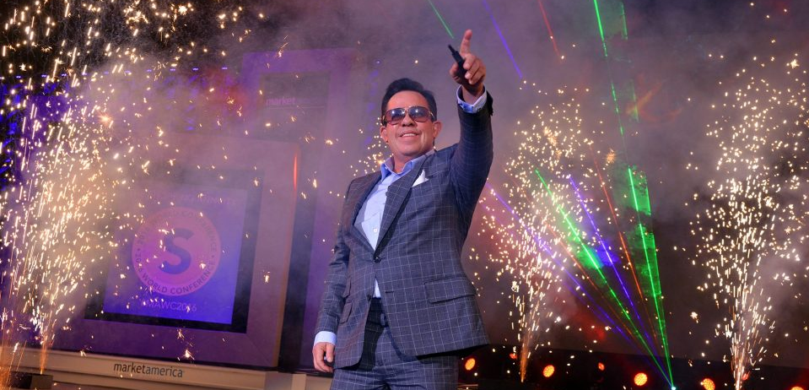
Your journey to SUCCESS begins with

